Slide 1

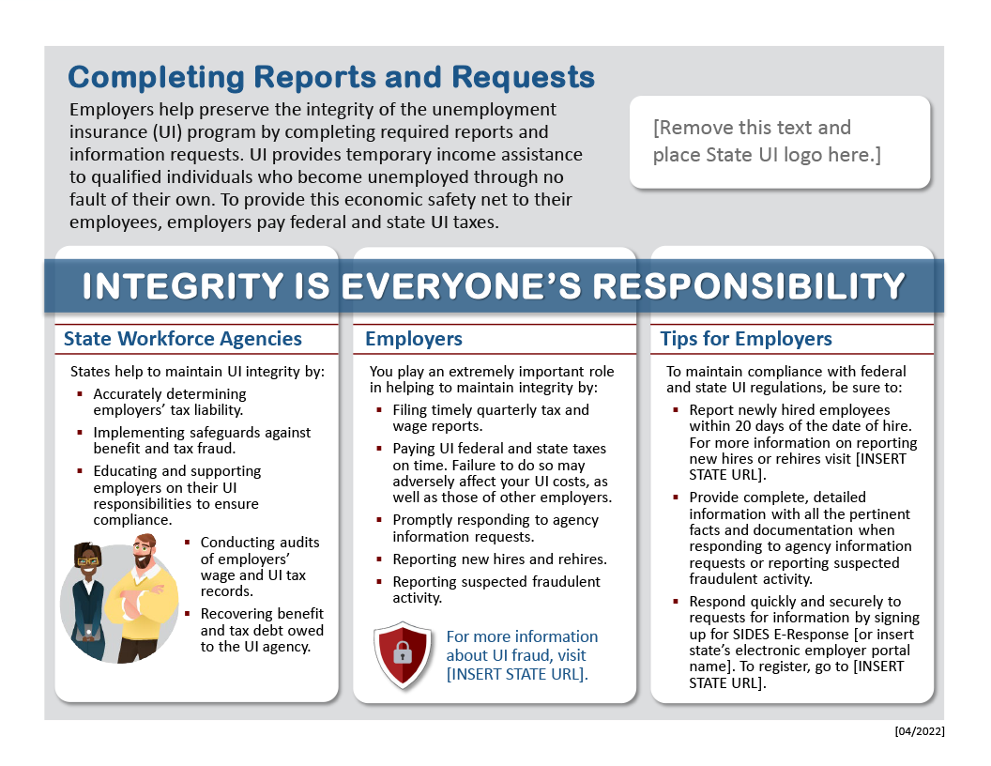
CUSTOMIZING THIS GUIDE
Completing Reports and Requests
The following Guide is ready to be modified for use by your agency.
Read through all the text and look for brackets – this is where you insert your agency information.
If your state uses a different term for unemployment insurance, such as unemployment compensation or reemployment services, please customize the guide to fit your state’s vocabulary.
Consider saving the document as a PDF for distribution.
For assistance in customizing the Guide, contact UISIDES@naswa.org.
Modify Slide 2 for your agency.

Slide 2


Completing Reports and Requests
Employers help preserve the integrity of the unemployment insurance (UI) program by completing required reports and information requests. UI provides temporary income assistance to qualified individuals who become unemployed through no fault of their own. To provide this economic safety net to their employees, employers pay federal and state UI taxes.
[Remove this text and place State UI logo here.]
INTEGRITY IS EVERYONE’S RESPONSIBILITY
State Workforce Agencies
Employers
Tips for Employers
States help to maintain UI integrity by:
Accurately determining
employers’ tax liability.
Implementing safeguards against benefit and tax fraud.
Educating and supporting employers on their UI responsibilities to ensure compliance.
    Conducting audits of employers’
    wage and UI tax records.
    Recovering benefit and tax debt owed to the UI agency.
You play an extremely important role in helping to maintain integrity by:
Filing timely quarterly tax and wage reports.
Paying UI federal and state taxes on time. Failure to do so may adversely affect your UI costs, as well as those of other employers.
Promptly responding to agency information requests.
Reporting new hires and rehires.
Reporting suspected fraudulent activity.
To maintain compliance with federal and state UI regulations, be sure to:
Report newly hired employees within 20 days of the date of hire. For more information on reporting new hires or rehires visit [INSERT STATE URL].
Provide complete, detailed information with all the pertinent facts and documentation when responding to agency information requests or reporting suspected fraudulent activity.
Respond quickly and securely to requests for information by signing up for SIDES E-Response [or insert state’s electronic employer portal name]. To register, go to [INSERT STATE URL].
For more information about UI fraud, visit [INSERT STATE URL].
[04/2022]

